Slide 1

MVGR ALUMNI
Connect Share Help

Slide 2
Introduction
So many alumni are facing Issues while connecting each other. And to share thoughts and their views. And also facing issues to get help, to get different point of views from different professions.
Sharing thoughts and success stories from different friends working in different professions, help them to get more opportunities in their career.

Slide 3
Problem Statement
Design a web-based alumni connect platform for a college that helps alumni register, network and share success stories. Focus on clean, responsive frontend design that promotes engagement and ease of use.

Slide 4
Pain points
Alumni face problems to connect each other.
To find them in other social media platforms like linkedin.
Getting updated about college and technologies.
Getting point of views of different professions.
To know about each other like in which position their friends are.

Slide 5
Features
Connect with each other
Get referrals from friends
Give referrals to friends
Helping each other
Share their thoughts and success stories
To start any business with freinds

Slide 6
Implementation
Technologies used:
HTML
CSS
JS

Slide 7
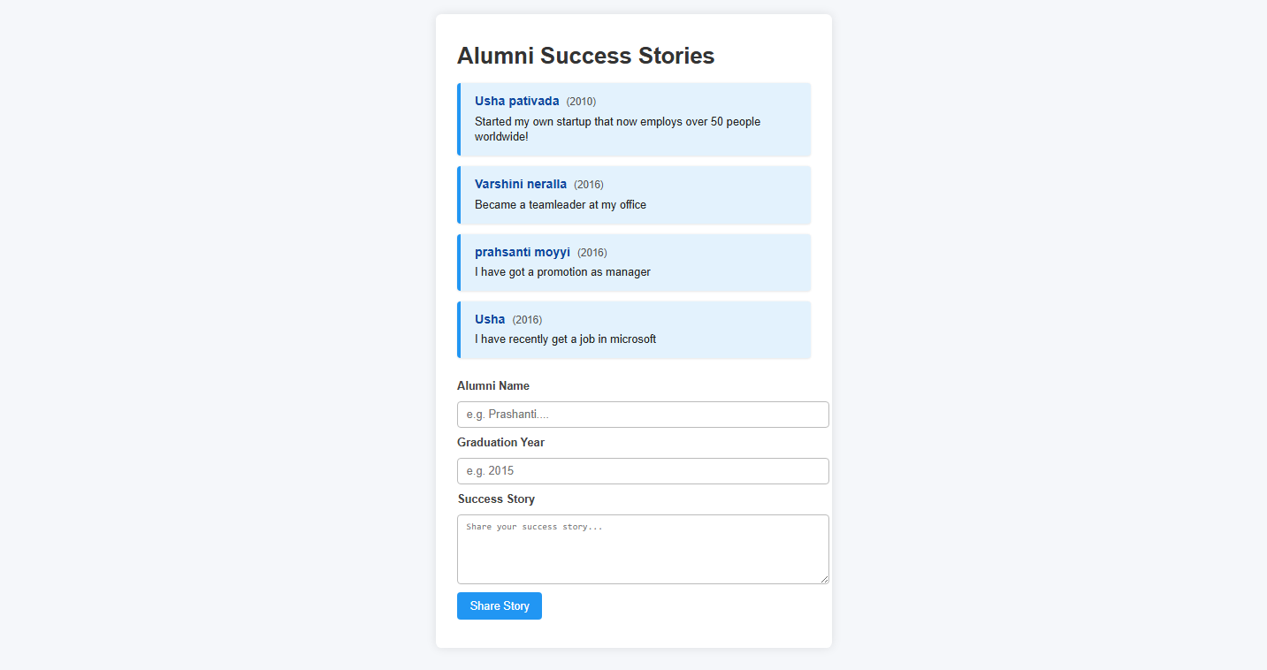
Prototype

